Slide 1
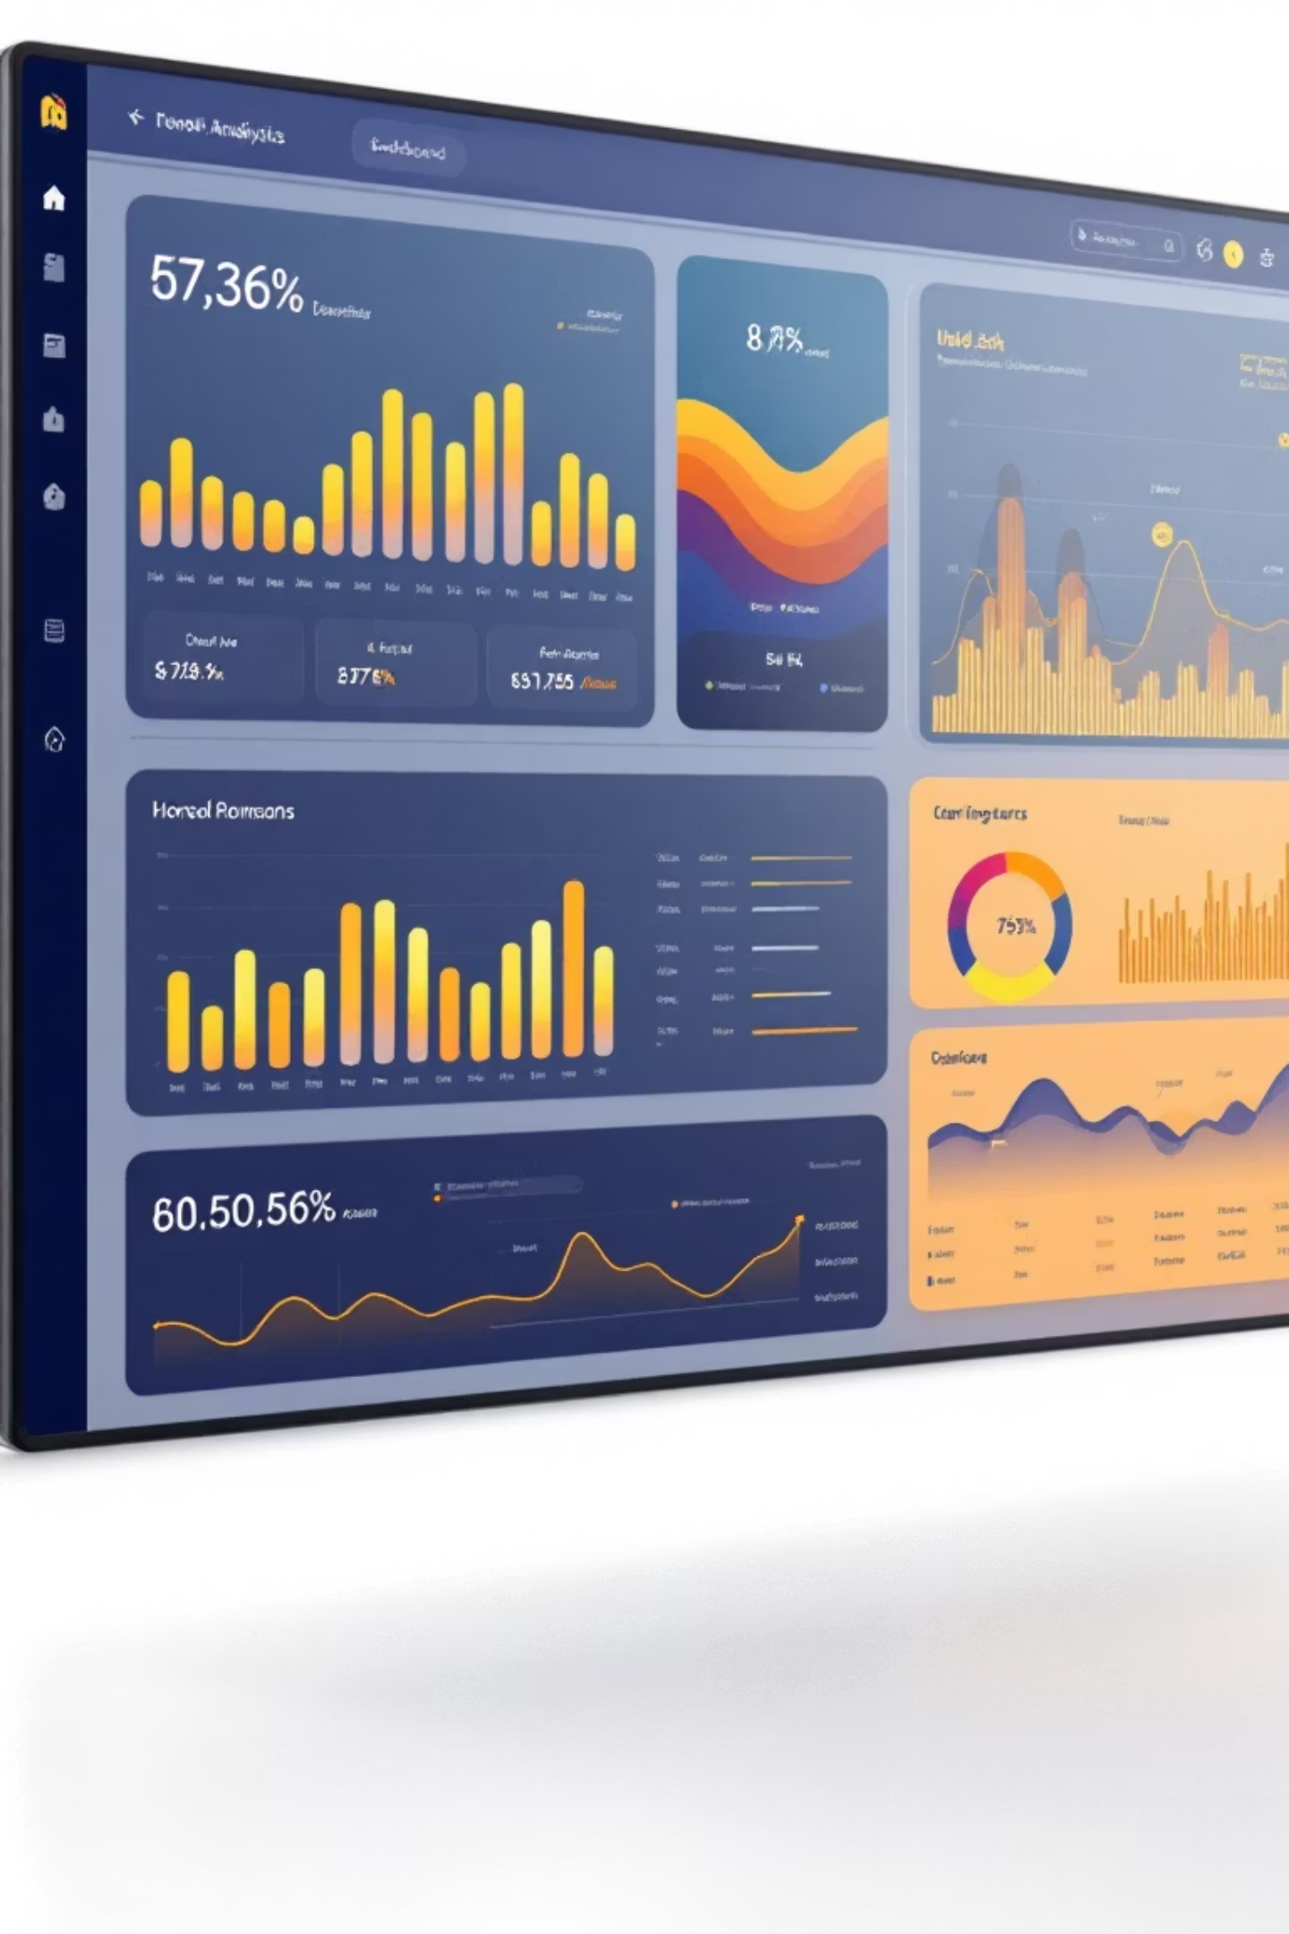

Business and Campaign Analysis for Simple Threads
Capstone Project
Course: Basics Of Data Analytics (BDA)
Created By: Daksh Khandelwal

Slide 2
Project Objective & Scope
Business Questions
Time Period
Data Sources
Analysis addresses customer behaviour patterns, revenue drivers, and campaign effectiveness to inform strategic decisions.
January to March 2025, capturing complete Q1 performance across all business metrics.
Four comprehensive datasets: customer information, product catalogue, purchase transactions, and discount campaigns.
This analysis provides management with actionable insights to optimize inventory, pricing strategy, and marketing investments for sustained growth.

Slide 3

Data Overview
Customer_Information
Product Information
Demographic profiles including gender, age group, location, and registration dates for all customers in the database.
Complete product catalogue with categories, pricing, sizes, and colours across the entire inventory range.
Purchase Information
Discount Information
Transaction-level data capturing customer purchases, quantities, pricing, and timestamps for Q1 2025.
Campaign participation records showing discount percentages applied and customer engagement levels.
All datasets underwent thorough data cleaning to ensure accuracy and consistency for reliable analysis.

Slide 4
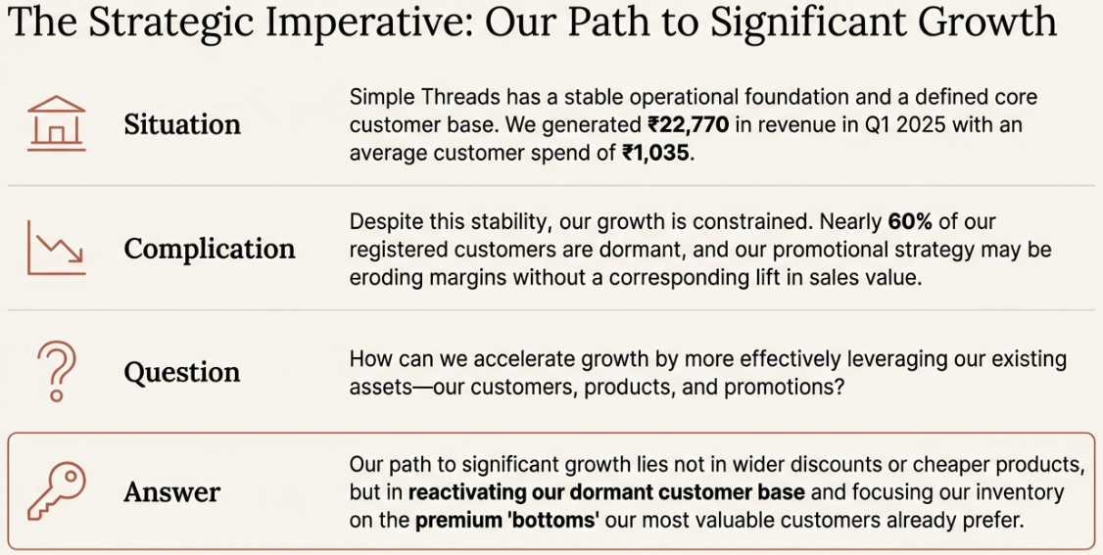

Slide 5
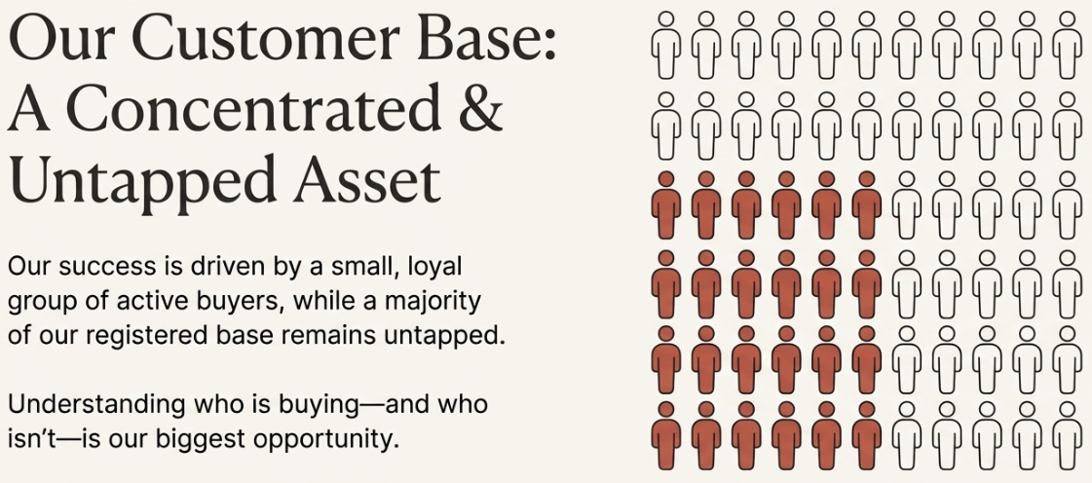

Slide 6
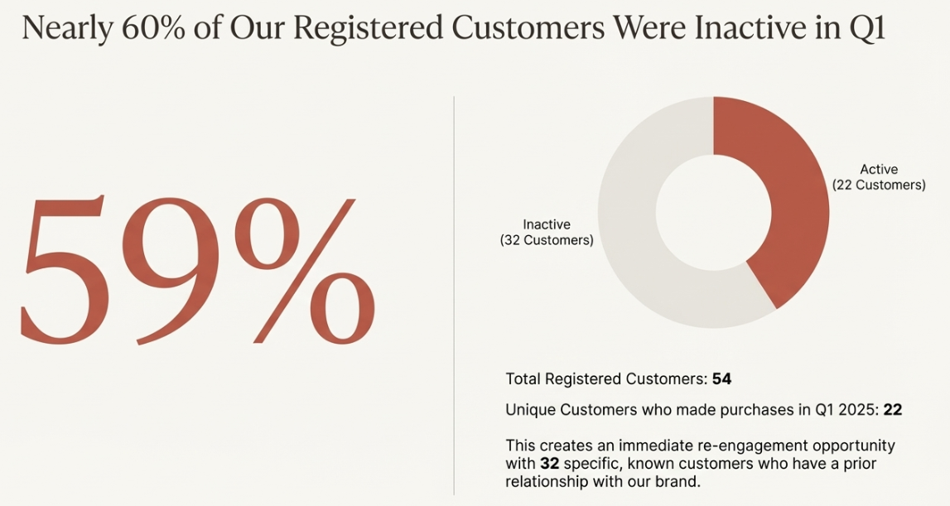

Slide 7
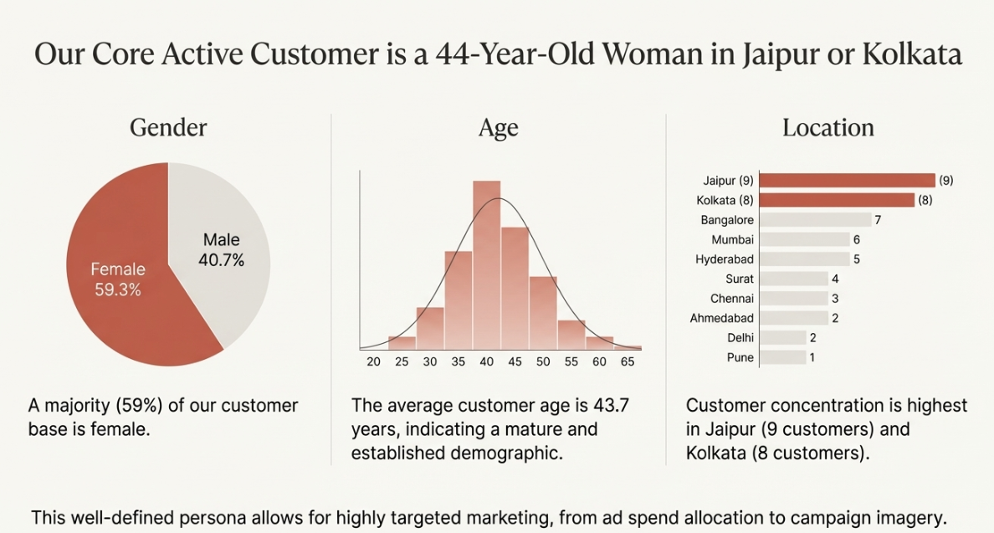


Slide 8
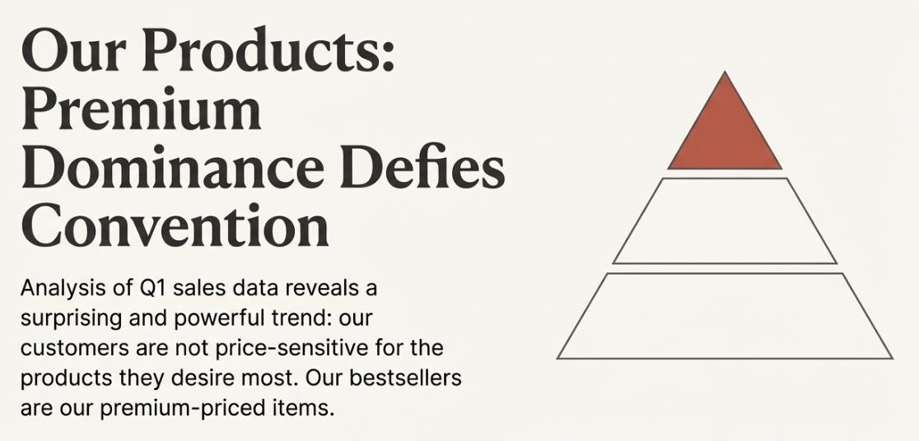

Slide 9
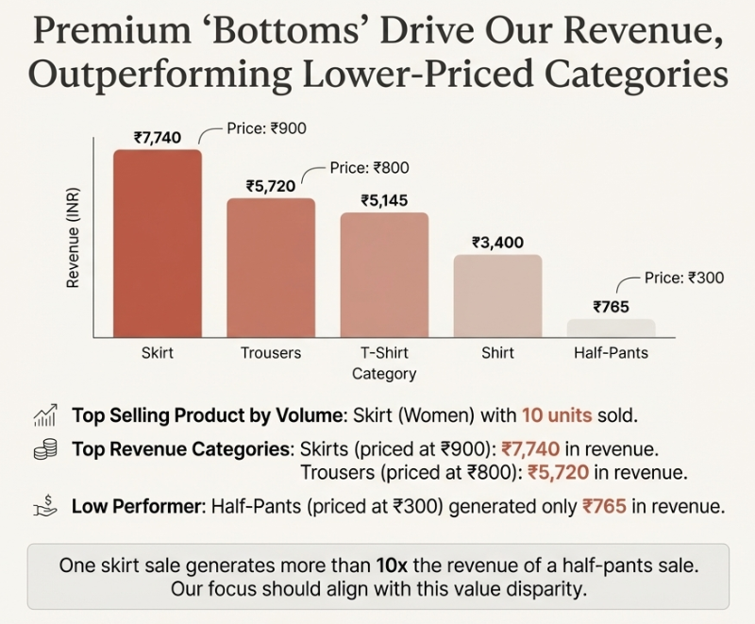

Slide 10
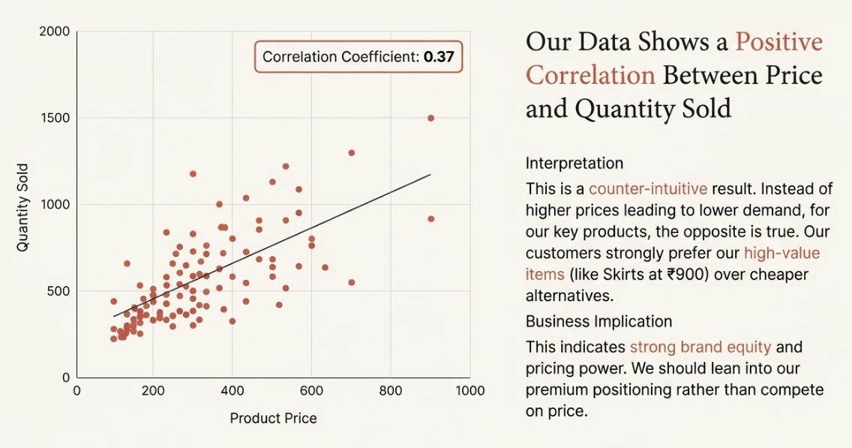

Slide 11

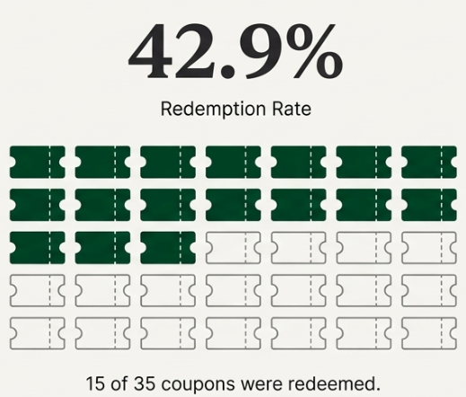

Slide 12
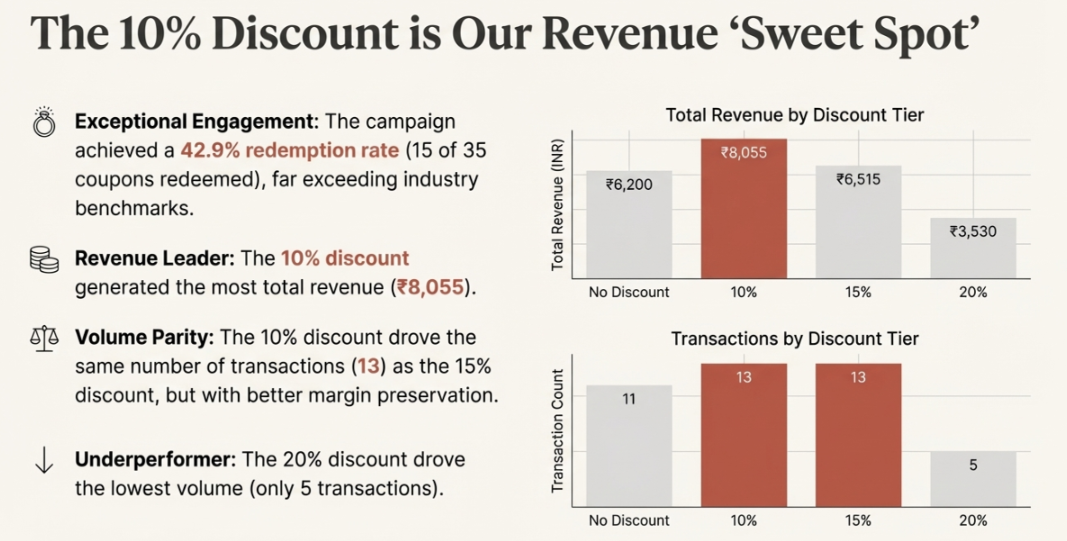

Slide 13
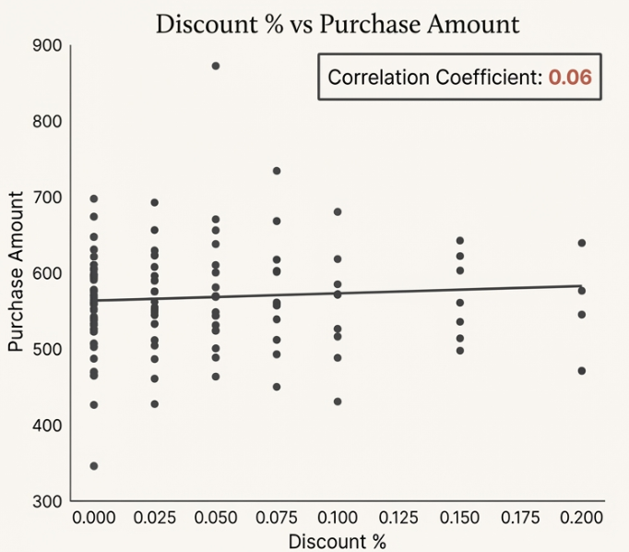
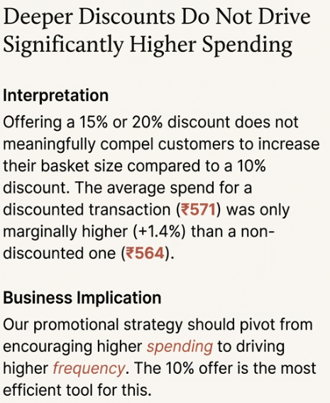
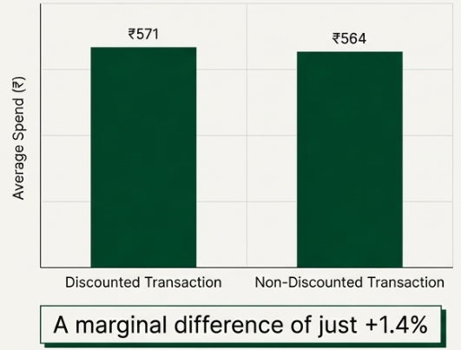

Slide 14
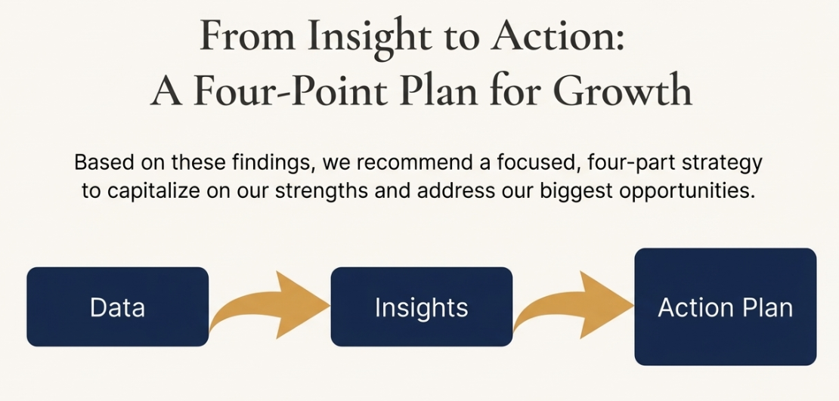

Slide 15
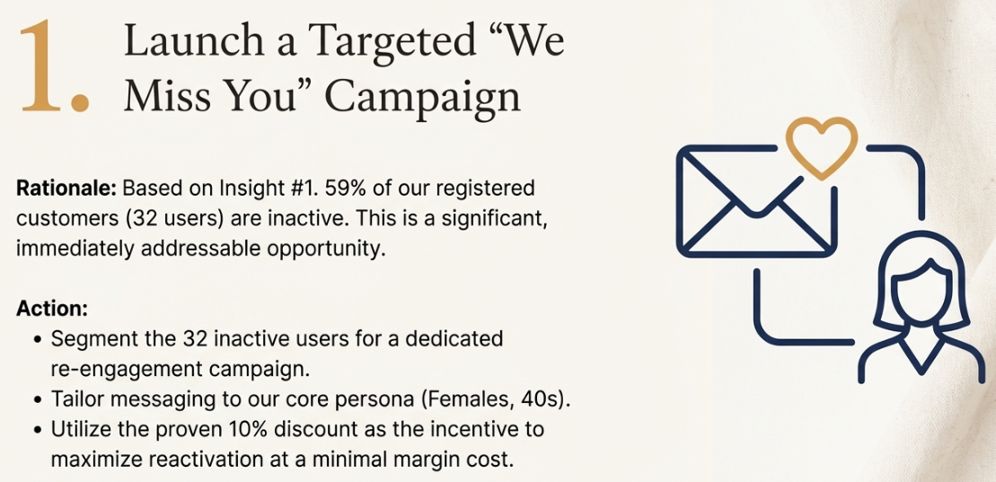

Slide 16
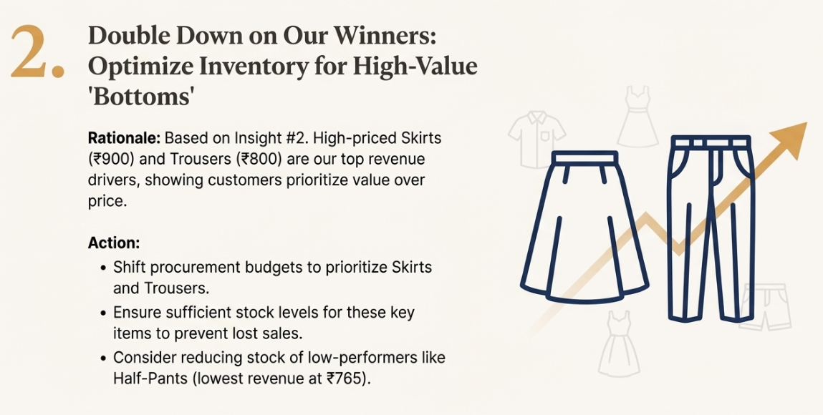

Slide 17
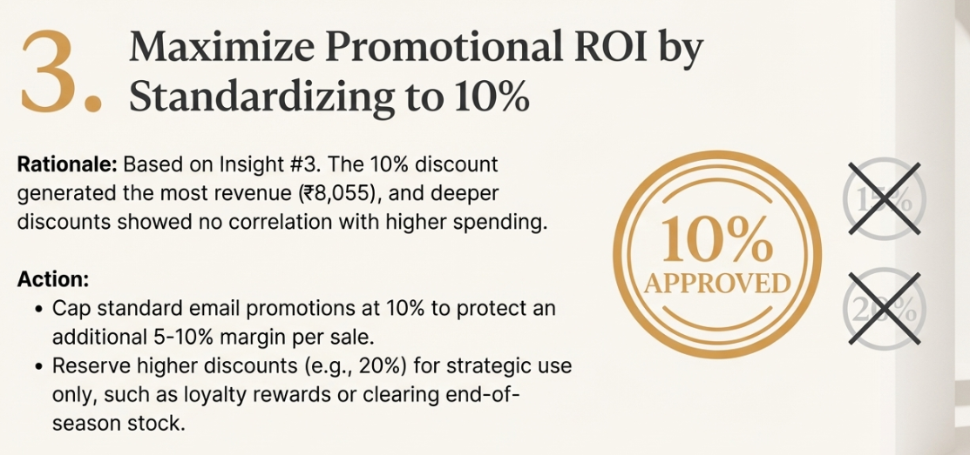

Slide 18
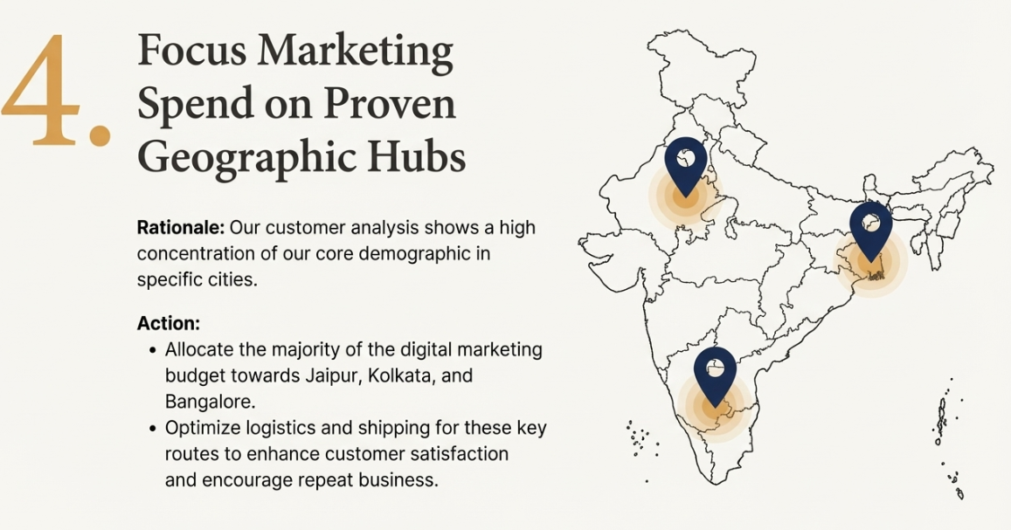

Slide 19
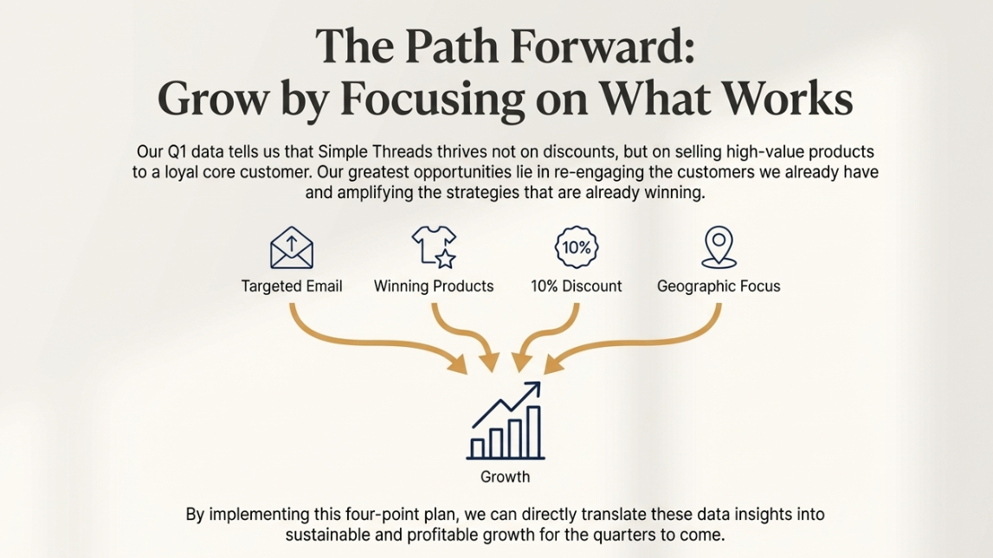

Slide 20

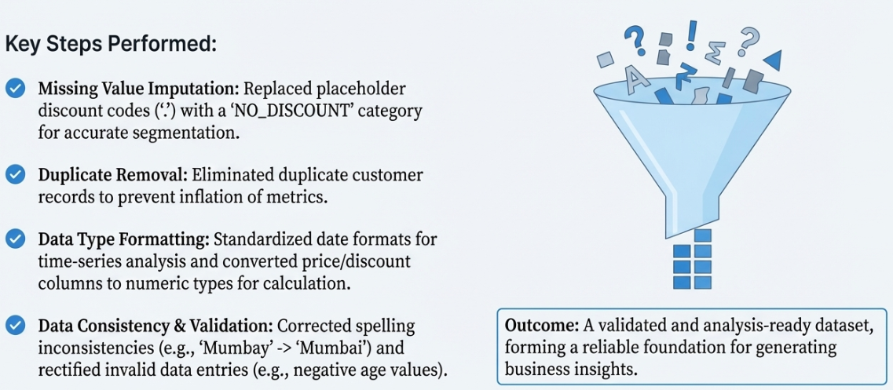
Appendix & Questions
Data Integrity & Methodology
Full Report: https://drive.google.com/file/d/1-bCcxSMICMtd-Z4GR3_RoLBGU5FDXUhS/view?usp=sharing
Questions?
I welcome your feedback and queries on our analysis and recommendations.

Slide 21


